Slide 1
REPRESENTING REAL NUMBERS ON NUMER LINE
Example 1

Slide 2
MATERIALS REQUIRED
Cardboard
Chart
Sketch pens
LED lights
Batteries and wires
Model cars
Ruler

Slide 3
Plan of action
Fix real number on a number line in the interval [0,3] or between (0 , 3)

Slide 4
Separate the number lines into three separate lanes

Slide 5
Lane-1 (0<=x<=1) Lane-2 (1<x<=2) Lane-3 (2<x<=3)

Slide 6
If a person chooses any random number then the fixed car models will move on the corresponding lane

Slide 7
Example if we press the number 2.06 then the car will move on the 2nd lane

Slide 8
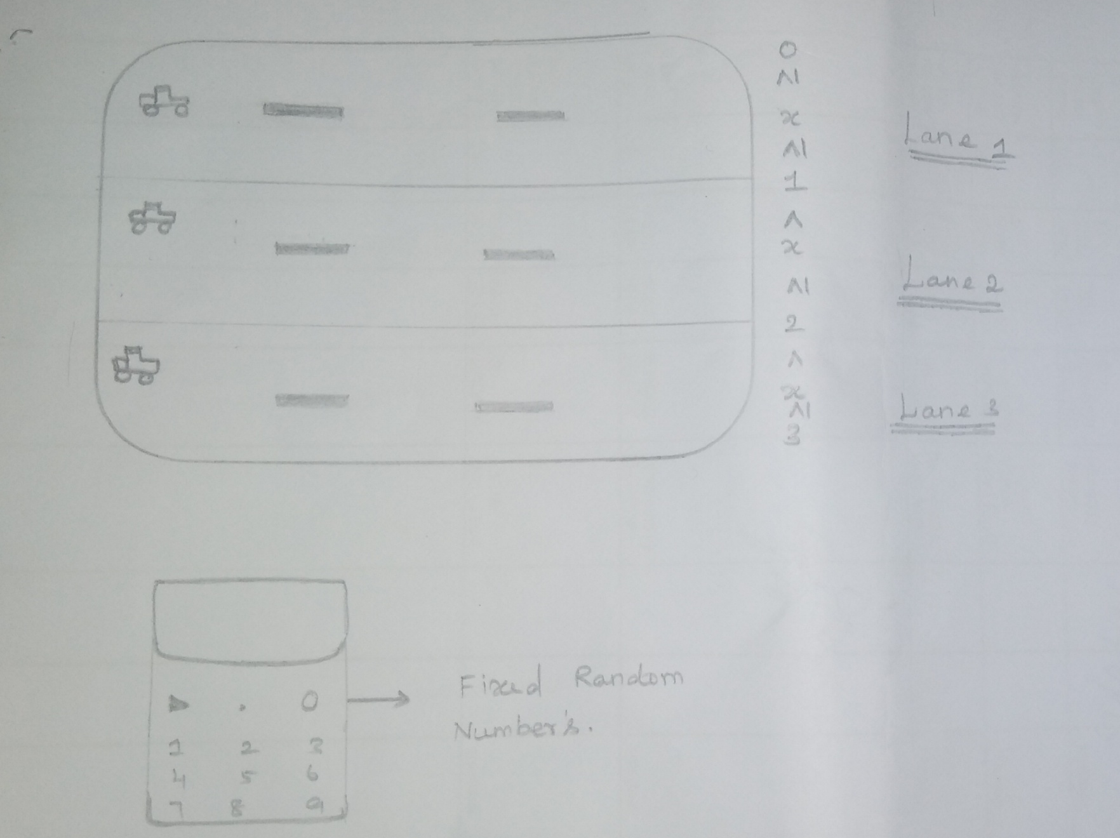
PROTOTYPE
EXAMPLE MODEL

